Slide 1
COVER SLIDE
Include the following on your cover slide:
Name of your startup/team
Team members (names, titles, roles, etc.)
Photos of team members or technology are allowed

Slide 2
VALUE PROPOSITION STATEMENT
Provide a succinct value proposition statement for your product/service that describes (100 words max.):
  your target customer
  their problems
  your product/service
  How it will benefit them
Highlight how your value proposition statement has changed based on the results of the last sprint

Slide 3
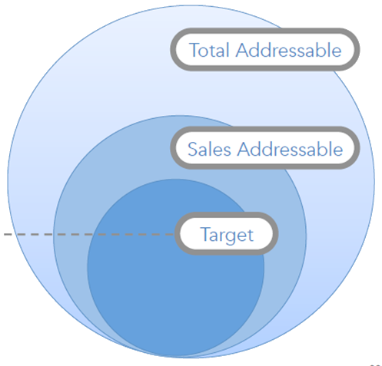
MARKET SIZE
Estimate the size of your market, and the justification for your estimates
TAM:
Type here
SAM:
Type here
Target Market:
Type here

Slide 4
Objectives for Sprint #1
What I did to Achieve Them
For Example:
Hypothesis to be tested
Experiments or key questions
Outreach plan
For Example:
Tools used for outreach
Events attended
Updates to invitation message or interview script

Slide 5
NUMBER OF INTERVIEWS
 | How many people have you contacted? | How many people have answered you? | Calculate your response rate (%) | Number of interviews completed | Number of interviews scheduled but not yet completed | Number of references obtained
New Interviews (since the last sprint)
TOTAL =

Slide 6
INSTRUCTIONS FOR HYPOTHESIS SLIDES
Complete at least one of the following hypothesis test learning slides for the interviews completed during sprint #1:
  Identify your customer segment (be as precise as possible)
  Identify the application area or industry related to the customer segment
  Provide the number of interviews conducted related specifically to testing this hypothesis
  Describe the hypothesis that was tested
  Indicate using a circle whether the hypothesis was validated
  Discuss your learnings and any insights gained; feel free to add quotes directly from your interviews
  Discuss the impact of what you have learned on your next steps (e.g. new hypotheses, different customer segments, etc.)
An example is provided of what is expected
Make a copy of the blank template before completing if you plan to present more than one hypothesis

Slide 7
Nurses in medium-size hospitals
2
Healthcare
We believe that nurses struggle to measure the patient’s vital signs due to the bulkiness of hospital equipment.
For this customer segment the user of my solution is not the same as my customer
✓
X
Nurses approx spend the first 10 minutes of their interaction with a patient moving around equipment to be able to take a patient's vital signs.
The equipment currently available only allows the nurse to check the patient’s vital sign directly from the equipment connected to the patient.
One nurse said: “when I come see a patient the first thing I need to do is take their vital signs, usually I need to check the equipment and I make sure I have easy access to the patient. That always takes some time! It is very annoying… and some of the equipment we have here is quite outdated…”
Nurses are not the decision maker for the solution I am building.
I will contact 20 hospital administrators to validate if the problem is important enough for them as it is for the nurses
Notes:
Watch the video that inspired this example: https://www.youtube.com/watch?v=f-8v_RgwGe0

Slide 8
Type here
n
Type here
Add hypothesis here
Type here
✓
X
…
…
…
Discuss next steps here

Slide 9
INSTRUCTIONS FOR BMC
Using the template on the next slide, provide an updated version of your business model canvas
Updates should be based on the interview results from the last sprint
Focus on the sections of your canvas related to the hypotheses you tested
Highlight areas that have changed from the last iteration of your canvas

Slide 10
Type name
Type #
Type here
Type here
Type here
Type here
Type here
Type here
Type here
Type here
Type here

Slide 11
PLAN FOR SPRINT #2
List your next hypotheses, the stakeholders you must interview to test them, and what questions you will ask
Hypotheses | Stakeholder | Questions

